Slide 1



Introduction about Git, GitHub & Copilot
Muralidharan Deenathayalan,
Associate Director – Software Innovation, Quanticate

Slide 2
Agenda
Version Control Systems
Git
GitHub
Visual Studio Code
OpenAI
Copilot
Q & A

Slide 3
Git
What is Git ?
Need of Git
History
Git’s Friends
Uses of Git
Features of Git
Git commands
Demo
Q & A

Slide 4
GitHub
What is GitHub ?
Need of GitHub
History
GitHub’s Friends
Uses of GitHub
Features of GitHub
GitHub commands
Demo
Q & A

Slide 5
Visual Studio Code(VSCode)
What is VSCode ?
Need of VSCode
History
VSCode’s Friends
Uses of VSCode
Features of VSCode
VSCode commands
Demo
Q & A

Slide 6
OpenAI
What is OpenAI ?
Features of OpenAI
Demo
Q & A

Slide 7
Copilot
What is Copilot ?
Need of Copilot
Pair Programming
Copilot’s Friends
Features of Copilot
Demo
Q & A

Slide 8
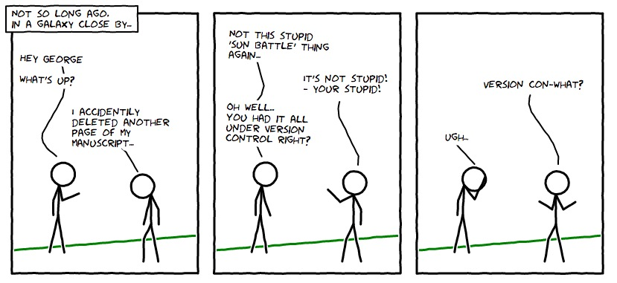
Version Control System
https://smutch.github.io/VersionControlTutorial/
Notes:
Turn back the clock whatever you want
Keeps track of everything
Facility in recreating things and evolute

Slide 9
Version Control System
Version Control is a system that records changes to a file or set of files over time, so that you can recall specific versions later.
Changes are called Versions.
Type of Changes : Added, modified, moved, renamed and deleted.
If you make any mistakes in the code and you can go back to old version.
https://git-scm.com/ , https://dev.to/gdahboy/git-for-begginers-3hd7
Notes:
Turn back the clock whatever you want
Keeps track of everything
Facility in recreating things and evolute

Slide 10
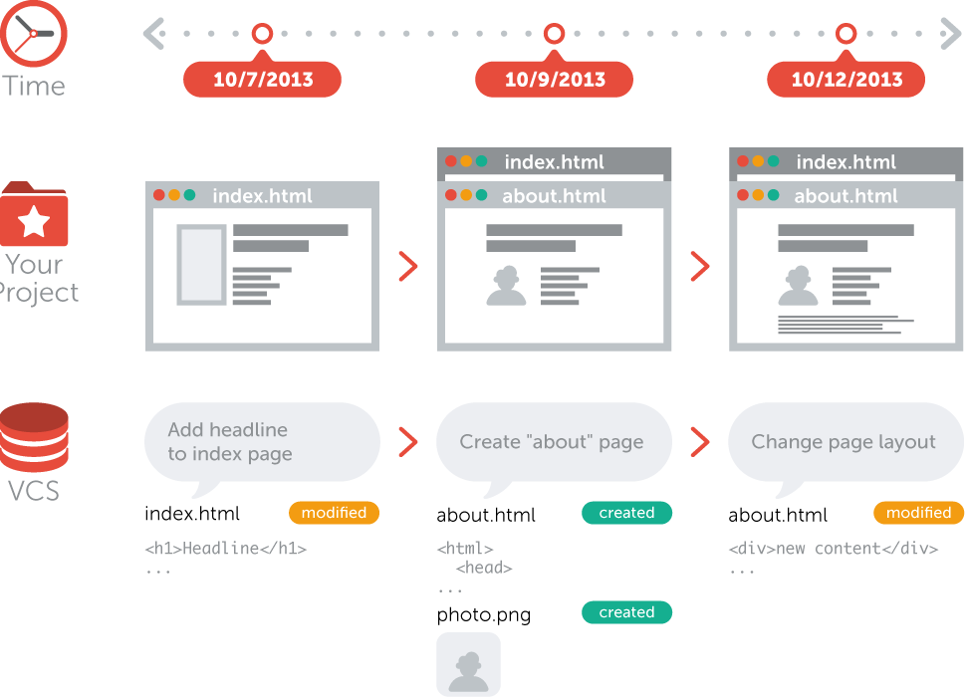
Version Control System
https://git-scm.com/, https://www.git-tower.com/learn/git/ebook/en/desktop-gui/basics/what-is-version-control/

Slide 11
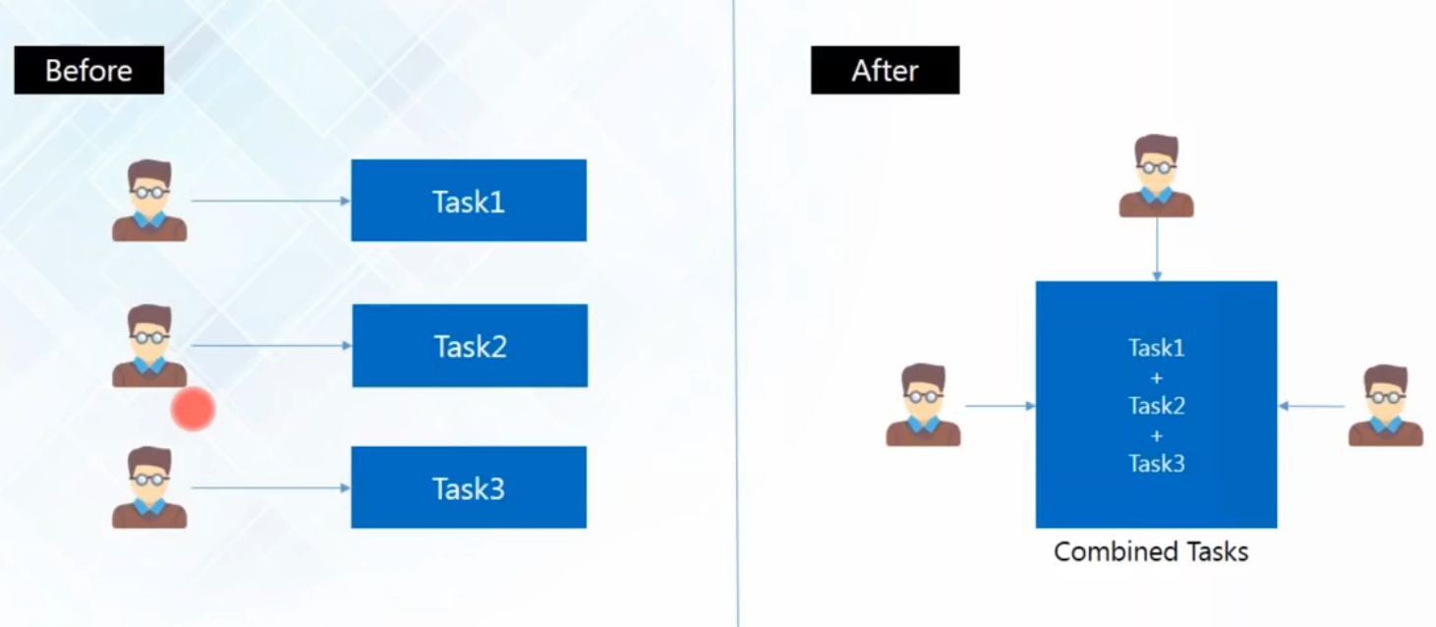
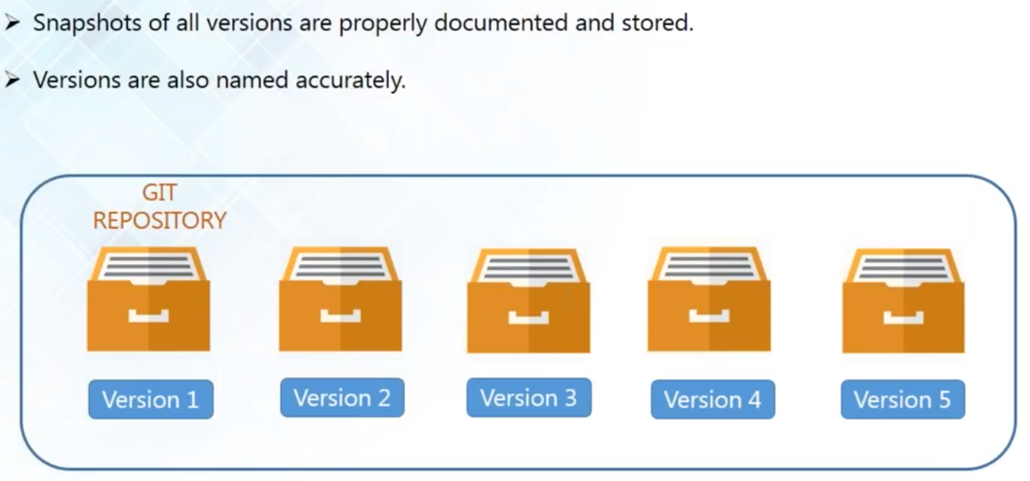
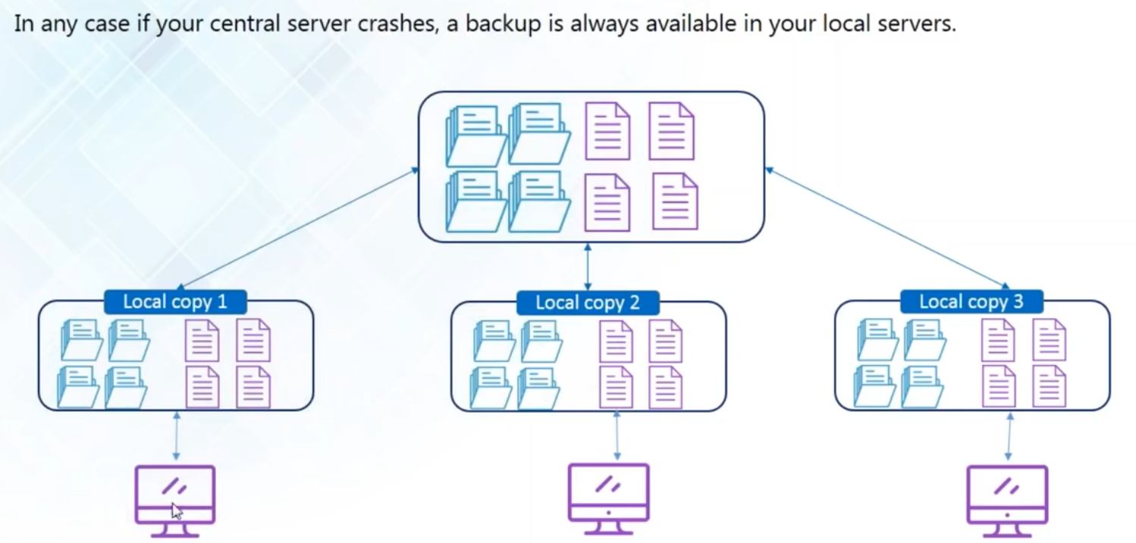
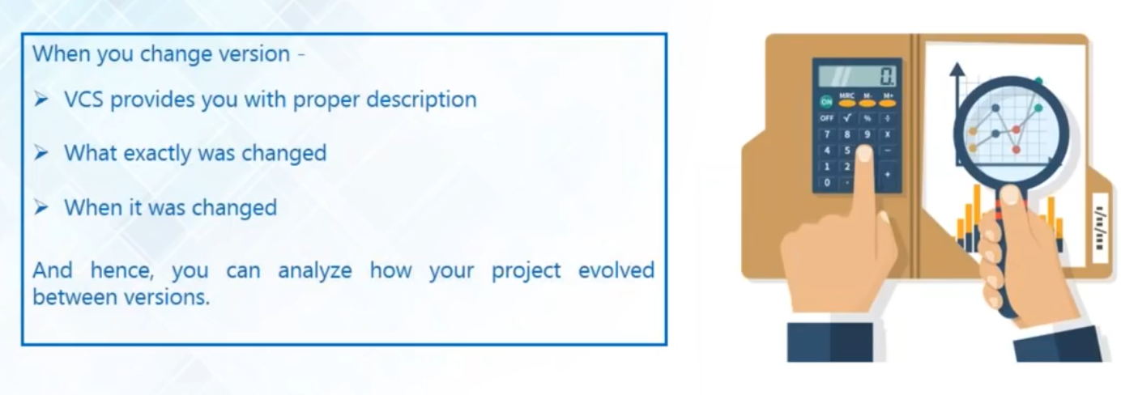
Version Control System – Why ?
Collaboration
Maintaining Versions
Backup
Source code Analyze
https://git-scm.com/ , https://dev.to/gdahboy/git-for-begginers-3hd7
Notes:
Collaboration :
Conflict on same file
File can be over written by other
Storing Version
Modified file or the whole project
Versions are stored with comments (Reason for the changes)
GO back any time
Backup
Central server
Local Copy
Reliable backup
Analyze
Comments
What changed
When it was changed

Slide 12
Version Control System – Types
Centralized Version Control System
Distributed Version Control System
https://git-scm.com/ , https://dev.to/gdahboy/git-for-begginers-3hd7

Slide 13
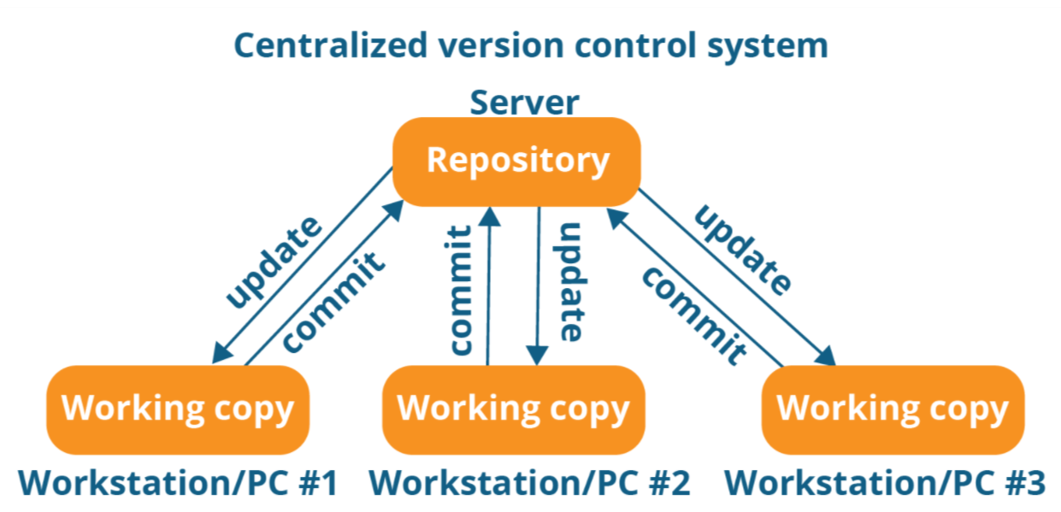
Version Control System – Centralized CVS
https://faun.pub/centralized-vs-distributed-version-control-systems-a135091299f0
Notes:
Centralized systems are typically easier to understand and use
You can grant access level control on directory level
performs better with binary files

Slide 14
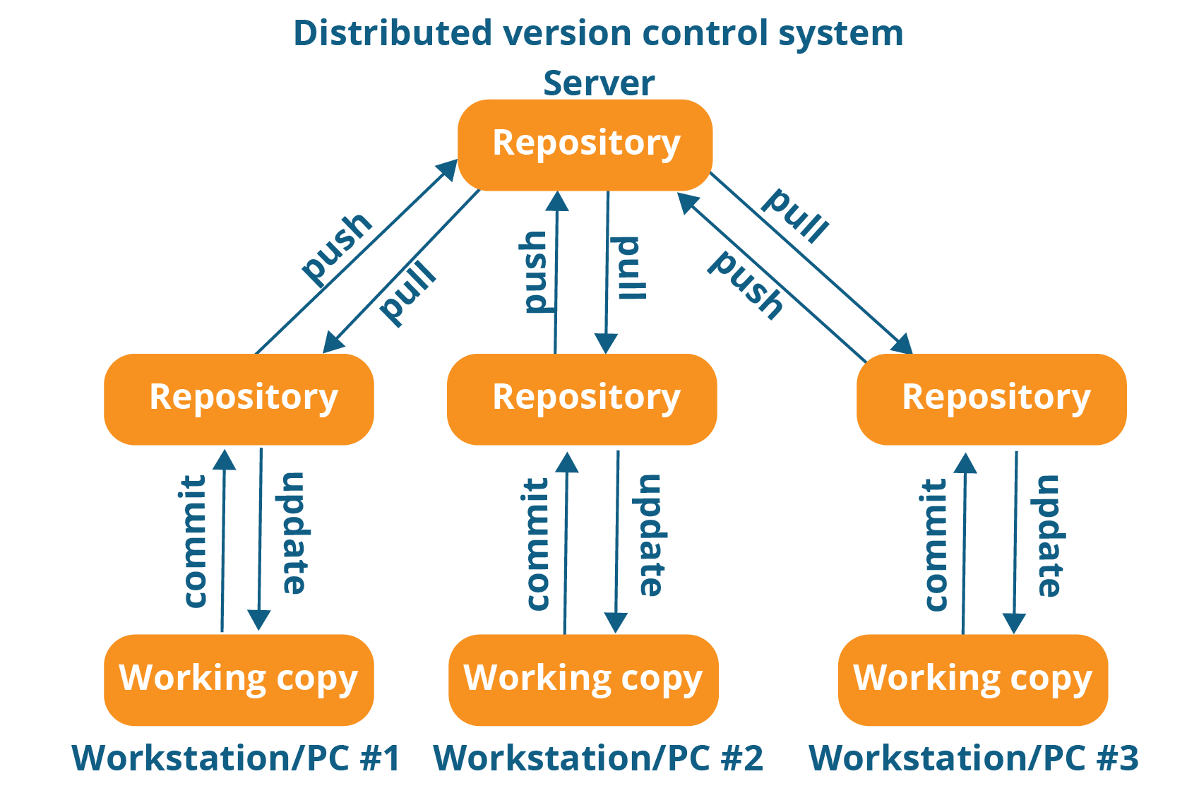
Version Control System – Distributed CVS
https://faun.pub/centralized-vs-distributed-version-control-systems-a135091299f0
Notes:
Advantages
Backup - Always local copy with all files
Speed – Over internet
Performance of distributed systems is better
Branching and merging is much easier
With a distributed system, you don’t need to be connected to the network all the time (complete code repository is stored locally on PC)

Slide 15
Version Control System – Centralized vs Distributed
https://faun.pub/centralized-vs-distributed-version-control-systems-a135091299f0
Notes:
Performance of distributed systems is better
Branching and merging is much easier
With a distributed system, you don’t need to be connected to the network all the time (complete code repository is stored locally on PC)

Slide 16




Version Control System – Tools
Centralized
Distributed
Git
Mercurial

Slide 17
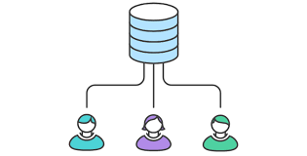
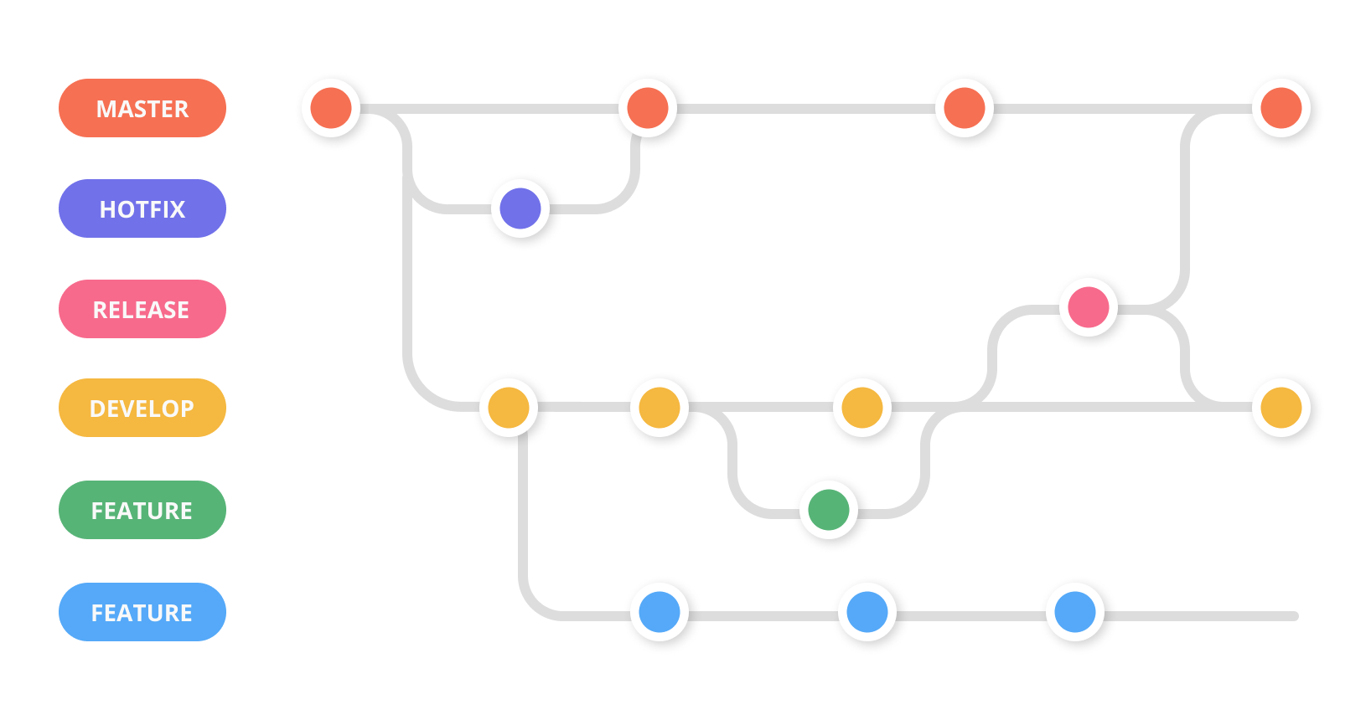
Git
Free and Open Source (GPLv2)
Distributed Version Control System
Collaboration
Supports Distributed non-linear workflow
https://git-scm.com/ , https://opensource.org/licenses/GPL-2.0

Slide 18
Git Features
Distributed
Non-linear
Branching
Lightweight
Speed
Open Source
Reliable
Secure
Economical
https://git-scm.com/ , https://opensource.org/licenses/GPL-2.0

Slide 19
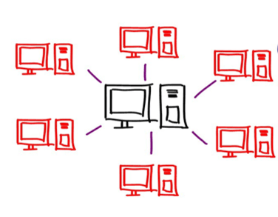
Git Features - Distributed
Source code is distributed
Every developer has a local copy
Changes are synced with other repos
Notes:
Allows distributed development of code
Every developer has a local copy
Changes are synced from one repo to another repo

Slide 20
Git Features - Non-linear
Tree graph structure
Tree is non-linear
Supports non-linear development of S/W
Notes:
Generating Tree graph from the index – Tree is non-linear
Supports non-linear development of software
Included various techniques to navigate & visualise non-linear development history

Slide 21
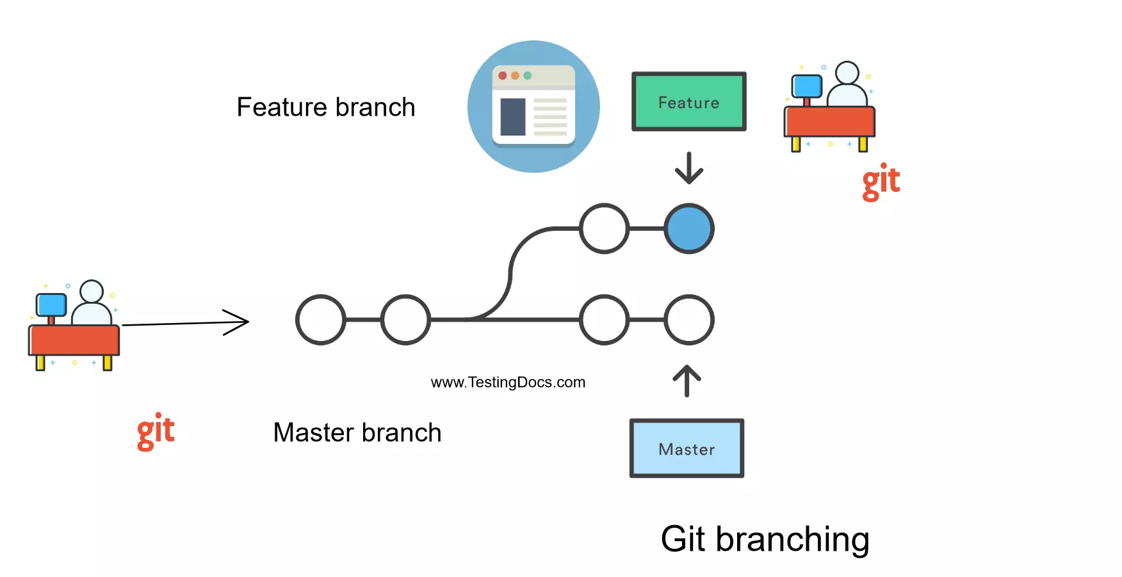
Git Features - Branching
Copy of current branch to another
Few seconds to create & merge
Master branch – Production code
Operations in each branch are independent – like delete, rename..

Slide 22
Git Features - Lightweight
Loseless Compression technique at client-side

Slide 23
Git Features - Speed
Accessing data from local repo is much faster than remote repo
Git is faster 10 times than VCS tools
Git is written in C (nearly machine language)
https://git-scm.com/ , https://opensource.org/licenses/GPL-2.0

Slide 24
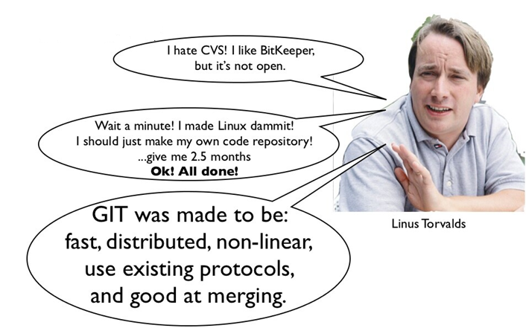

Git Features - Open Source
https://www.slideshare.net/mikeflynn_/git-its-better-trust-me

Slide 25
Git Features - Reliable
Can be easily recovered from any one of the local repo.

Slide 26
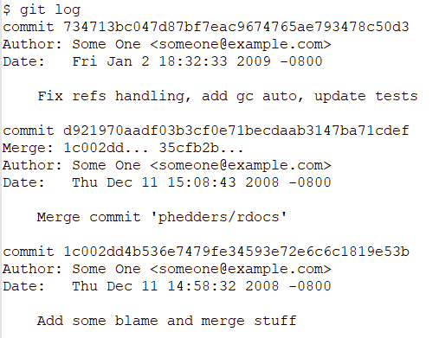
Git Features - Secure
Git uses SHA1 to name the objects
40 digits hexadecimal code
https://git-scm.com/ , https://opensource.org/licenses/GPL-2.0

Slide 27
Git Features - Economical
Free
GPLv2 License
Not required costly servers
https://git-scm.com/ , https://opensource.org/licenses/GPL-2.0

Slide 28
Git - Repository
Folder / directory contains source code, text or images of a project.
Local Repository - It can live on the local machine.
Central Repository - It can live on GitHub, GitLab or Bitbucket.
https://git-scm.com/ , https://opensource.org/licenses/GPL-2.0

Slide 29
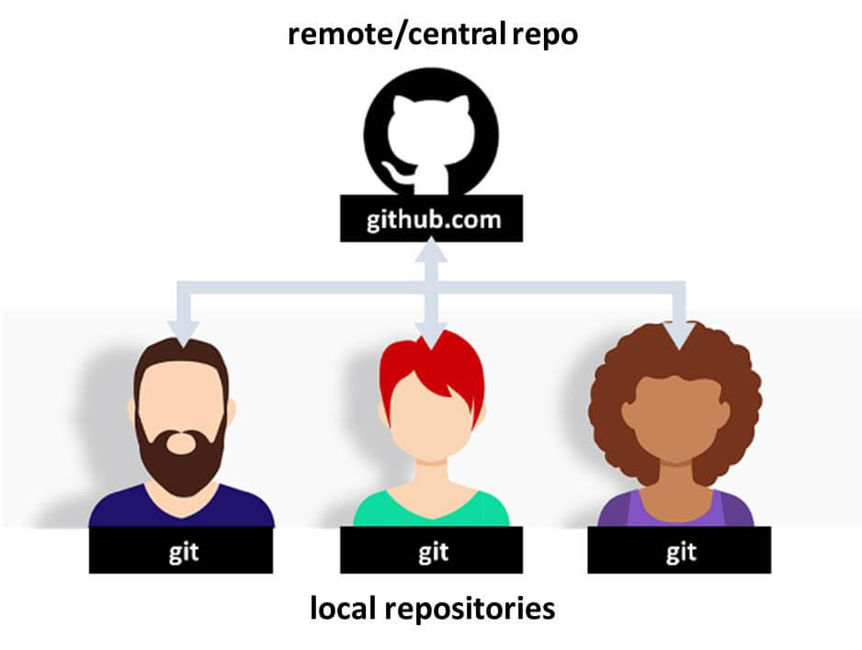
Git - Repository
https://phpenthusiast.com/blog/the-essentials-of-git-and-github-for-web-developers

Slide 30
Git - Repository
Local Repository
Located on local machine
Resides as a .git folder inside the project’s root folder
User of the local machine can work
Central Repository
Located on remote server (GitHub)
Exclusively consists of .git repository folder
Collaboration of source code
https://phpenthusiast.com/blog/the-essentials-of-git-and-github-for-web-developers

Slide 31
Git Operations
git init
git add
git checkout
git clone
git commit
git pull
git merge
https://git-scm.com/ , https://opensource.org/licenses/GPL-2.0
Notes:
Git is a DVCS tool that supports distributed non-linear workflows by providing data assurance for developing quality software

Slide 32
Git & GitHub – Demo
Install Required softwares
GitHub Account setup
Create Central Repo
Create Local Repo
Sync
Making changes on Local Repo
Branching
Merging
Sync
https://git-scm.com/ , https://opensource.org/licenses/GPL-2.0
Notes:
Git is a DVCS tool that supports distributed non-linear workflows by providing data assurance for developing quality software

Slide 33
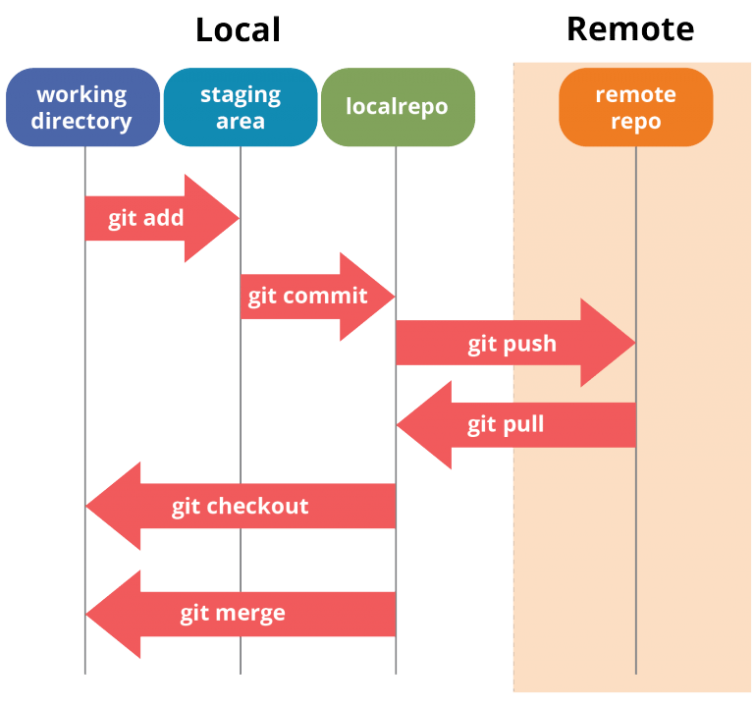
Git – Demo
https://www.edureka.co/blog/git-tutorial/#operations_in_git
Notes:
Git is a DVCS tool that supports distributed non-linear workflows by providing data assurance for developing quality software

Slide 34
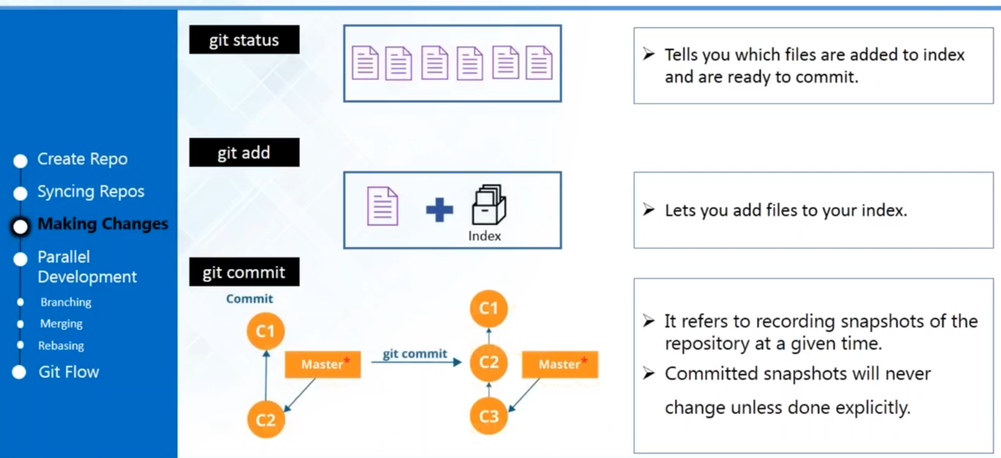
Git – Demo
https://git-scm.com/ , https://opensource.org/licenses/GPL-2.0
Notes:
Git is a DVCS tool that supports distributed non-linear workflows by providing data assurance for developing quality software

Slide 35

Visual Studio Code
Source code editor from Microsoft.
Announced on Build conference on April 29, 2015.
Release on November 18, 2015 under MIT License.
Source code is available at GitHub under MIT license.
Built-in version control system.
Supports Java, C#, JavaScript, Go, Node JS, Python etc
Can be extended via Extensions like debugger, new language support.
Notes:
The MIT License is a permissive free software license originating at the Massachusetts Institute of Technology (MIT)^{[7]} in the late 1980s

Slide 36
Visual Studio Code - Demo
How to add an existing vs code project /folder to Git & GitHub?
How to do Pull, Commit and Push?
How to do Clone from GitHub?
How to do remove project from GitHub?

Slide 37

OpenAI
OpenAI is an AI research and deployment company
Founded by Elon Musk, Sam Altman + others late 2015.
Elon Musk resigned on Feb 2018 but remains as donor.
In 2019, Microsoft invested US $ 1billion and become as a commercial partner.

Slide 38
OpenAI – Product Releases
On April 2016,OpenAI released OpenAI Gym for Reinforcement Learning research.
Generative Pre-trained Transformer released on June 11, April 2018.
GPT 2 released on February 2019.
GPT 3 released on May 2020.
Notes:
Generative Pre-trained Transformer

Slide 39
OpenAI – GPT 3
It is an Unsupervised Transformer Language Model.
Successor for GPT 2.
Pre-training required several thousand petaflop/s-days of compute.
API calls are paid, and it has free trial of 2 months.
On September 23, 2020, GPT-3 was licensed exclusively to Microsoft.
Notes:
Autoaggressive language mode with 175 billion parameters
Generative Pre-trained Transformer 3
One petaflop/s-day is approximately equal to 10²⁰ neural net operations

Slide 40
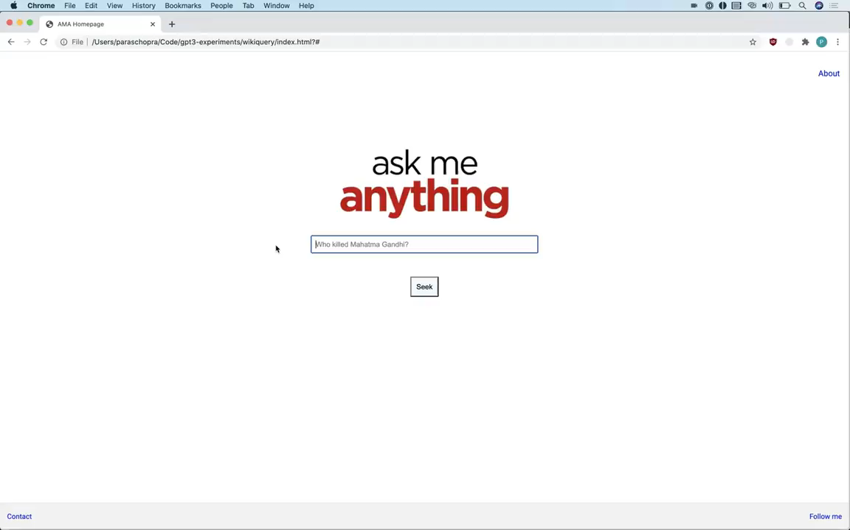
Open AI – App 1 Search Engine

Slide 41
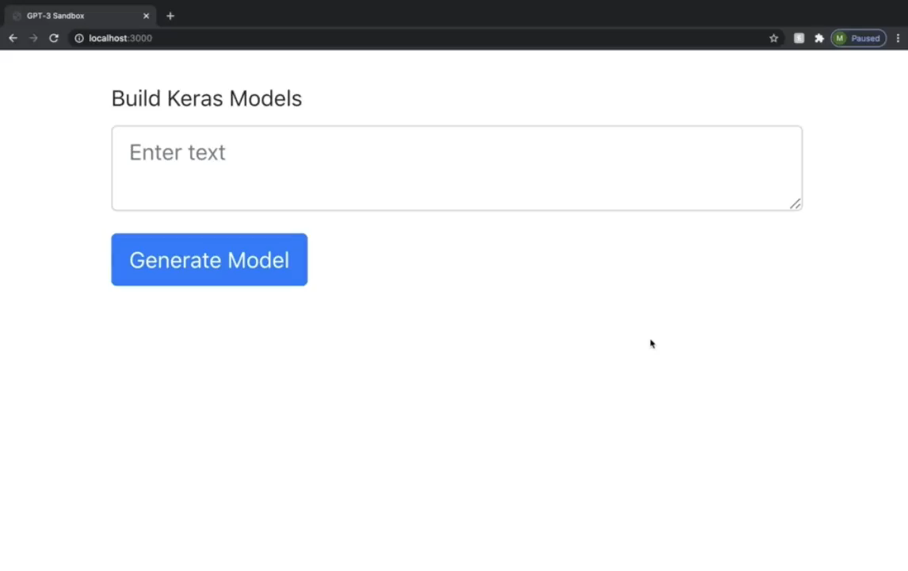
Open AI – App 2 ML Code Generator

Slide 42
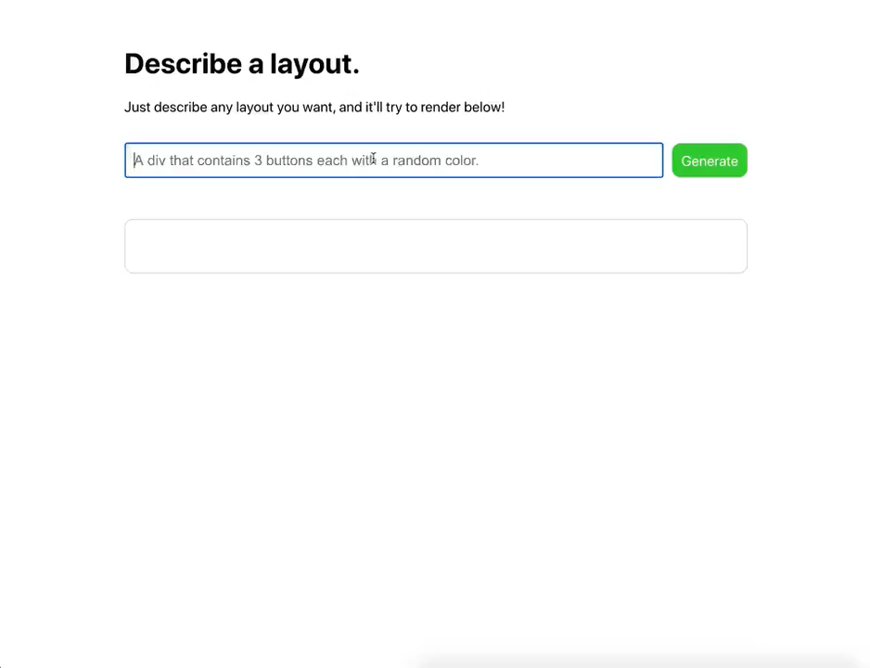
Open AI – App 3 HTML Layout

Slide 43
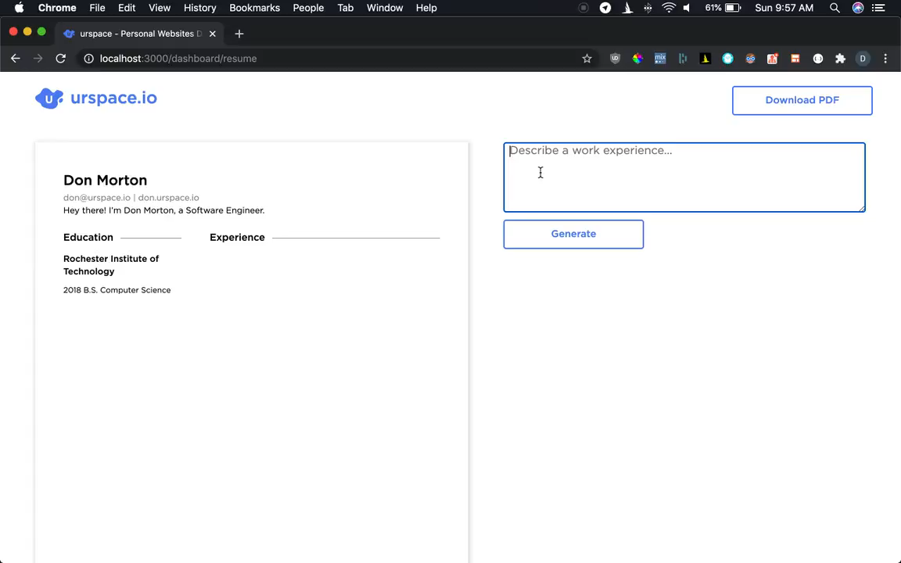
Open AI – App 4 Resume Builder
https://analyticsindiamag.com/openai-gpt-3-model-machine-learning-products/

Slide 44
GitHub Copilot
What is Git ?
Need of Git
History
Git’s Friends
Uses of Git
Features of Git
Git commands
Demo
Q & A

Slide 45
Copilot
OpenAI developed Codex.
An AI that translates natural language into code.
Pair Programming.

Slide 46
GitHub Copilot
GitHub Source Code + OpenAI’s Codex = GitHub Copilot

Slide 47
GitHub Copilot
AI tool developed by GitHub and OpenAI to assist users of VS code by providing Auto code complete.
First announced on Jun 29, 2021.
It used modified version of GPT -3 (Codex).
Copilot is trained on public GitHub repositories of any license.
AI based alternatives – Tabnine, Kite
Notes:
a descendant from GPT-3 that provides a deeper understanding of the context than other assistants

Slide 48
GitHub Copilot - Advantages
Autocode completion.
Better logic implementation.
Improves productivity.
Notes:
Its creators expect Copilot to “enable existing engineers to be more productive, reducing manual tasks and helping them focus on interesting work.”

Slide 49
GitHub Copilot - Disadvantages
May be suitable to experienced developer?
Low quality code
Insecure code
Referencing outdated API
Legal issues
Notes:
Its creators expect Copilot to “enable existing engineers to be more productive, reducing manual tasks and helping them focus on interesting work.”

Slide 50
GitHub Copilot - Setup
Installation and configuration
Notes:
Its creators expect Copilot to “enable existing engineers to be more productive, reducing manual tasks and helping them focus on interesting work.”

Slide 51
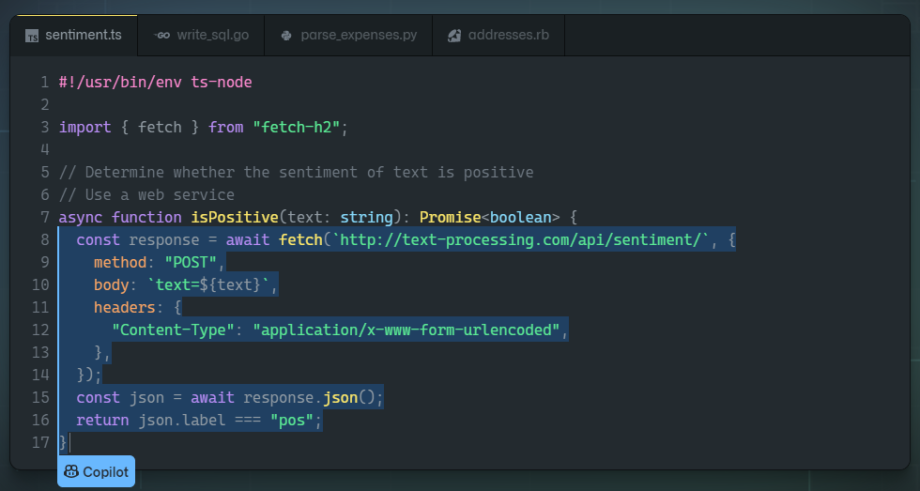
GitHub Copilot - Demo
Notes:
Its creators expect Copilot to “enable existing engineers to be more productive, reducing manual tasks and helping them focus on interesting work.”

Slide 52
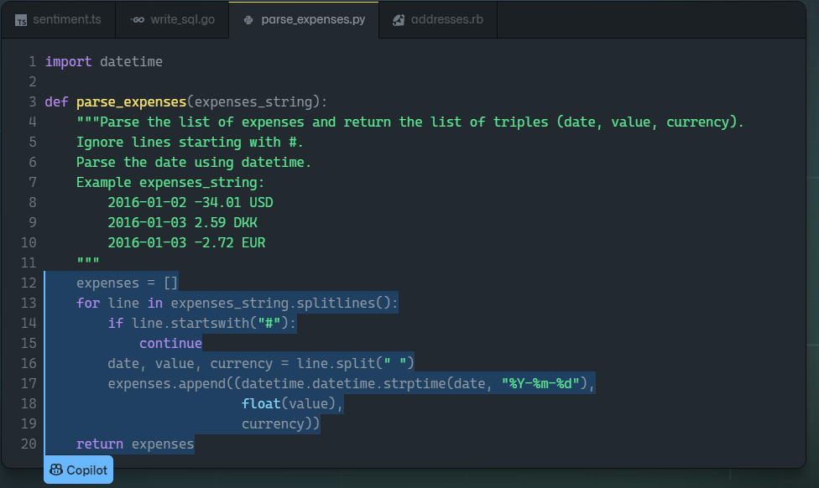
GitHub Copilot - Demo
Notes:
Its creators expect Copilot to “enable existing engineers to be more productive, reducing manual tasks and helping them focus on interesting work.”

Slide 53
GitHub Copilot - Conclusion
GitHub, Microsoft, and OpenAI have reached a new milestone.
Notes:
Its creators expect Copilot to “enable existing engineers to be more productive, reducing manual tasks and helping them focus on interesting work.”

Slide 54
Keep in touch
Muralidharan Deenathayalan
Blogs : www.codingfreaks.net
Twitter : https://twitter.com/muralidharand
GitHub : https://github.com/muralidharand
LinkedIn : https://www.linkedin.com/in/muralidharand

Slide 55
References

Slide 56
Thanks
Thank You

